Slide 1
Progress Report – Multicontact Capturability
GABRIEL ENRIQUE GARCÍA CHÁVEZ
2019

Slide 2

Avoiding minimize Kinetic Energy:
Possible over-stoping (undershooting) and a step behind will be necessary.
$$\left\{\begin{aligned}\ddot{x}=\frac{f}{r}x \\ \ddot{z}=\frac{f}{r}z−g\end{aligned}\right.;1≥f≥0$$

Slide 3

Avoiding minimize Kinetic Energy:
Reason of undershooting: Ballistic trajectory is below global trajectories.
Ballistic trajectory points decrease under certain conditions.
In particular for 2D VHIP Fixed CoP:
$$z_{c}<\frac{g}{2}T^{2}$$
Graphically:

Slide 4
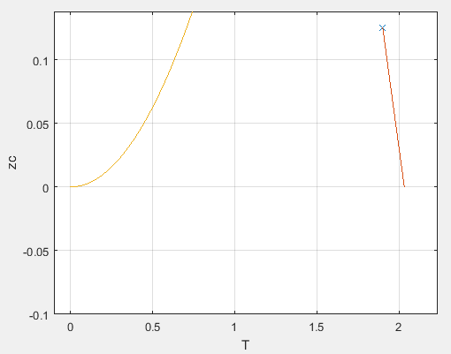
Avoiding minimize Kinetic Energy:
In state space:

Slide 5
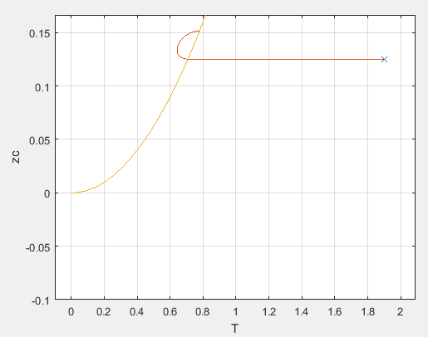

Avoiding minimize Kinetic Energy:
First idea: Wait until reaching the Projected Point and then stabilize.
Bang-bang control:
$$f=\left(z_{c}−\frac{g}{2}T^{2}\right)>0$$
Good results. With unbounded force controls the state space $z_{c}≥0$, $T≥0$.

Slide 6
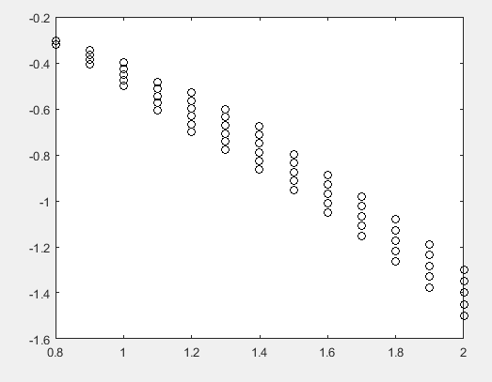

Avoiding minimize Kinetic Energy:
Bang-bang control:
$$f=\left(z_{c}−\frac{g}{2}T^{2}\right)>0$$

Slide 7

Avoiding minimize Kinetic Energy:
Second idea: Define a function and control it.
$$V=η=\left({\dot{x}}^{2}+{\left(\dot{z}−gT\right)}^{2}\right)−\frac{2z_{c}}{g}$$
$$\dot{η}=fη_{2}(x)$$
$${\dot{η}}_{2}=fη_{3}(x)+η_{4}(x)$$
w.
$$η_{3}\left(x\right)>0$$
Bang-bang control:
$$f=\left(η_{2}\left(x\right)<0\right)\left(η_{4}\left(x\right)<0\right)$$
Better results:

Slide 8
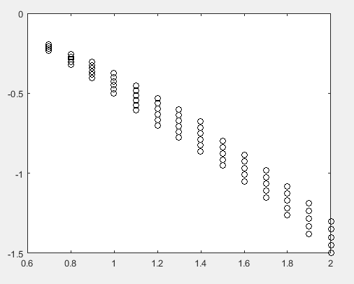
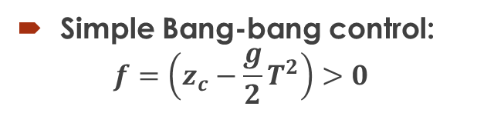
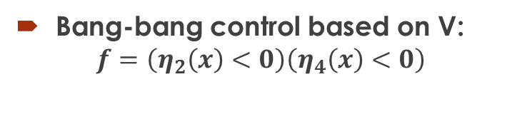
Avoiding minimize Kinetic Energy:
Simple Bang-bang control:
$$f=\left(z_{c}−\frac{g}{2}T^{2}\right)>0$$
Bang-bang control based on V:
$$f=\left(η_{2}\left(x\right)<0\right)\left(η_{4}\left(x\right)<0\right)$$

Slide 9
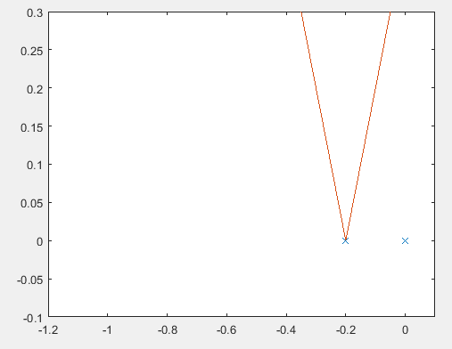

More complexity
Friction Constraint:
$$\dot{θ}>0$$
Wait until crossing Friction boundary. Controllable if and only if $z_{C}>0$

Slide 10

More complexity
Maximimum force and Friction Constraint:
$$\frac{z}{\left|x\right|}>μ and \dot{θ}>0$$
Necessary and sufficient: Wait until crossing Friction boundary and analyze for the “crossing” state.

Slide 11
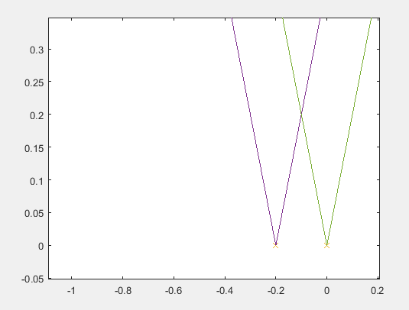

More complexity
“n” coplanar contact points w/Friction Constraints:
System equivalent to 2D VHIP var. CoP.
Necessary and sufficient: $∃r_{P}∈CH$ with $z_{c}>0$.

Slide 12
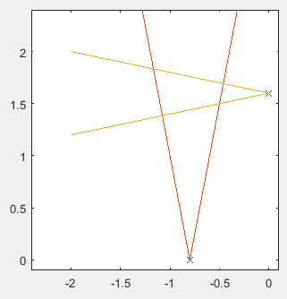

More complexity
At least 2 non-coplanar contact points w/Friction Constraints:
System equivalent to 2D VHIP var. CoP with CoM-dependent Contact Surface.
In that particular case: Still Necessary and sufficient: $∃r_{P}∈CH$ with $z_{c}>0$.

Slide 13
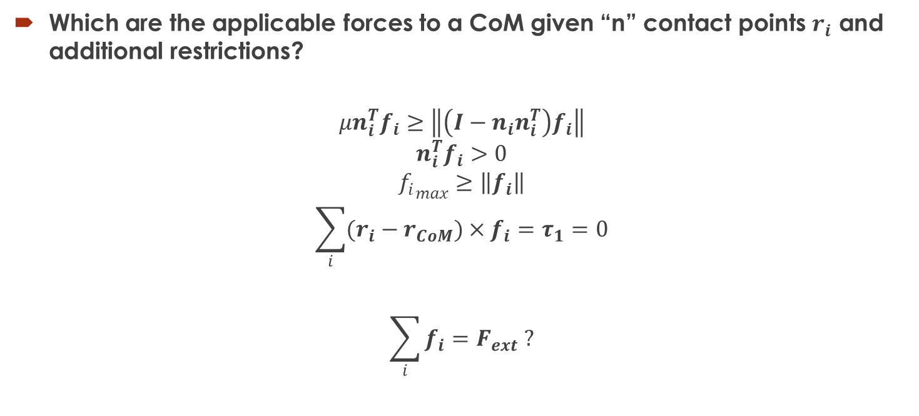
Convex Properties
Which are the applicable forces to a CoM given “n” contact points $r_{i}$ and additional restrictions?
$$μn_{i}^{T}f_{i}≥\left\|\left(I−n_{i}n_{i}^{T}\right)f_{i}\right\|$$
$$n_{i}^{T}f_{i}>0$$
$${f_{i}}_{max}≥\left\|f_{i}\right\|$$
$$\sum_{i}{(r_{i}−r_{CoM})×f_{i}}=τ_{1}=0$$
$$\sum_{i}{f_{i}}=F_{ext} ?$$

Slide 14


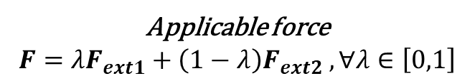
Convex Properties
Property: For a fixed CoM, the region of the allowed forces is convex.
$$F_{ext2}$$
Applicable force
$$F=λF_{ext1}+\left(1−λ\right)F_{ext2} , ∀λ∈\left[0,1\right]$$
$$F_{ext1}$$

Slide 15
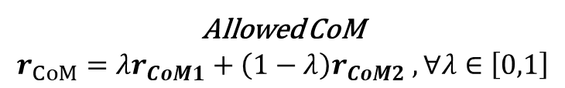





Convex Properties
Property: For a fixed given force, the region of the allowed CoMs is convex. Moreover, that region is a 2-D convex surface extruded infinitely in the direction of the force.
$$F_{ext}$$
$$F_{ext}$$
$$r_{CoM2}$$
$$F_{ext}$$
Allowed CoM
$$r_{CoM}=λr_{CoM1}+\left(1−λ\right)r_{CoM2} , ∀λ∈\left[0,1\right]$$
$$r_{CoM1}$$

Slide 16





Convex Properties
Property: For a fixed given force, the region of the allowed CoMs is convex. Moreover, that region is a 2-D convex surface extruded infinitely in the direction of the force.
$$F_{ext}$$
$$r_{CoM1}$$
Allowed CoM
$$r_{CoM}=r_{CoM1}+λ{\hat{F}}_{ext}, ∀λ∈ℝ$$
$$F_{ext}$$
$$r_{CoM}$$

Slide 17

Convex Properties
Consequence: We just need to find a 2D surface transversal to the direction of the given force:
$$F_{ext}$$
$$r_{CoM1}$$
$$F_{ext}$$
$$r_{CoM}$$

Slide 18
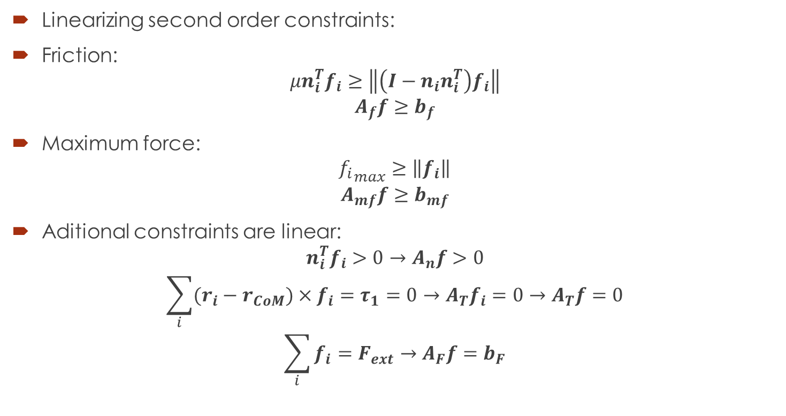
Convex Properties
Linearizing second order constraints:
Friction:
$$μn_{i}^{T}f_{i}≥\left\|\left(I−n_{i}n_{i}^{T}\right)f_{i}\right\|$$
$$A_{f}f≥b_{f}$$
Maximum force:
$${f_{i}}_{max}≥\left\|f_{i}\right\|$$
$$A_{mf}f≥b_{mf}$$
Aditional constraints are linear:
$$n_{i}^{T}f_{i}>0→A_{n}f>0$$
$$\sum_{i}{(r_{i}−r_{CoM})×f_{i}}=τ_{1}=0→A_{T}f_{i}=0→A_{T}f=0$$
$$\sum_{i}{f_{i}}=F_{ext}→A_{F}f=b_{F}$$

Slide 19



Convex Properties
Checking feasibility: Example of LP program:
1. $\max{0}$ s.t
$$A_{f}f≥b_{f}$$
$$A_{mf}f≥b_{mf}$$
$$A_{n}f>0$$
$$A_{T}f=0$$
$$A_{F}f=b_{F}$$
$$F_{ext}$$
$$r_{CoM}$$

Slide 20






Convex Properties
Finding transversal surface for given ${\hat{F}}_{ext}$:
Let’s manipulate the torque condition:
$$\sum_{i}{(r_{i}−r_{CoM})×f_{i}}=0$$
$$\sum_{i}{r_{i}×f_{i}}−r_{CoM}×F_{ext}=0$$
Linear on $f_{i}$ and $r_{CoM}$!
$$F_{ext}$$
$${\hat{v}}_{j}$$
$${\hat{v}}_{j}$$
$$r_{CoM0}$$

Slide 21




Convex Properties
Finding transversal surface for given ${\hat{F}}_{ext}$: Example of LP program:
1. Pick a random $r_{CoM0}$
2. Pick a random ${\hat{v}}_{j}$ holding ${\hat{v}}_{j}∙F_{ext}=0$. Can be defined by just an angle (1D).
3.$\max_{r_{CoM1},f}\left(r_{CoM1}−r_{CoM0}\right)∙{\hat{v}}_{j}$ s.t
$$A_{f}f≥b_{f}$$
$$A_{mf}f≥b_{mf}$$
$$A_{n}f>0$$
$$\sum_{i}{r_{i}×f_{i}}−r_{CoM1}×F_{ext}=0 \\ \left(r_{CoM1}−r_{CoM0}\right)∙{\hat{F}}_{ext}=0$$
$$F_{ext}$$
$${\hat{v}}_{j}$$
$$r_{CoM1}$$
$$r_{CoM0}$$
$${\hat{v}}_{j}$$

Slide 22
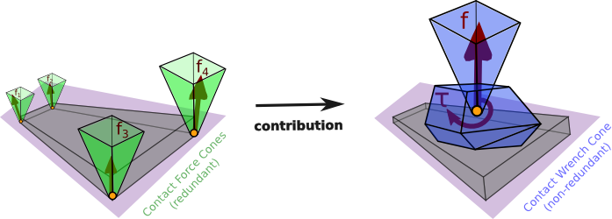
Another Perspective: CWC
All contact point forces with restrictions can be reduced to only a wrench independent of the Center of Mass.

Slide 23

Convex Properties
Finding transversal surface for given ${\hat{F}}_{ext}$: Example of LP program:
1. Pick a random $r_{CoM0}$
2. Pick a random ${\hat{v}}_{j}$ holding ${\hat{v}}_{j}∙F_{ext}=0$. Can be defined by just an angle (1D).
3.$\max_{r_{CoM1},f}\left(r_{CoM1}−r_{CoM0}\right)∙{\hat{v}}_{j}$ s.t
$$W_{T}f_{CWC}=0$$
$$\left(r_{CoM1}−r_{CoM0}\right)∙W_{F}f_{CWC}=0$$
$$F_{ext}$$
$${\hat{v}}_{j}$$
$$r_{CoM1}$$
$$r_{CoM0}$$
$${\hat{v}}_{j}$$

Slide 24





Convex Properties
Note: Full restrictions are second order constraints, the solution probably is not a polygon anymore, but it is still convex. We can still run the same program. Note that the function to maximize doesn’t change (still Linear).
$$F_{ext}$$
$${\hat{v}}_{j}$$
$$r_{CoM1}$$
$$r_{CoM0}$$
$${\hat{v}}_{j}$$

Slide 25
Back to Capturability - More complexity
At least 2 non-coplanar contact points w/Friction Constraints:
Non-zero Moment Region: Region where any non-zero force actuation on any contact point result in a Non-zero Moment around a point in the region.

Slide 26
Back to Capturability - More complexity
At least 2 non-coplanar contact points w/Friction Constraints:
For a given CoM you can apply any force, such that its infinite extension never crosses the Non-zero Moment Region.
Blue: Non-allowed force
Green: Allowed force

Slide 27
Back to Capturability - More complexity
At least 2 non-coplanar contact points w/Friction Constraints :
Sometimes, we no longer have a Center of Pressure, instead we have a “Center of Attraction”. In blue, an attractive line.

Slide 28
Back to Capturability - More complexity
At least 2 non-coplanar contact points w/Friction Constraints
Each subregion in the cutted space has it’s own Center of Pressure/Attraction region.

Slide 29

Back to Capturability - More complexity
At least 2 non-coplanar contact points w/Friction Constraints :
System equivalent to 2D VHIP var. CoP with CoM-dependent Contact Surface.
In that particular case: Still Necessary and sufficient: $∃r_{P}∈CH$ with $z_{c}>0$.

Slide 30





3D Region.
For a given ${\hat{F}}_{ext}$ the transversal region of allowed CoMs is the same regardless the maximum force constraint. It only affects the allowed magnitude of the applicable force:
$${\hat{F}}_{ext}$$
$$r_{CoM1}$$
$$F_{ext}$$
$$r_{CoM}$$

Slide 31

Back to Capturability - More complexity
At least 2 non-coplanar contact points w/Friction Constraints and Force:
System equivalent to 2D VHIP var. CoP with CoM-dependent Contact Surface and variable Maximum allowed force on each Center of pressure.
In that particular case: Still Necessary and sufficient: $∃r_{P}∈CH$ with $z_{c}>0$.

Slide 32
Minimizing Kinetic energy
Sufficient if the robot is over Static Stability Region.
Use the Minimum Kinetic energy control only if ballistic trajectory is increasing in a given point in the static stability region.
Use a controller that first brings the system to a safe region relative to the ballistic trajectory, and later minimize the kinetic energy.

Slide 33
Thanks!

